Slide 1
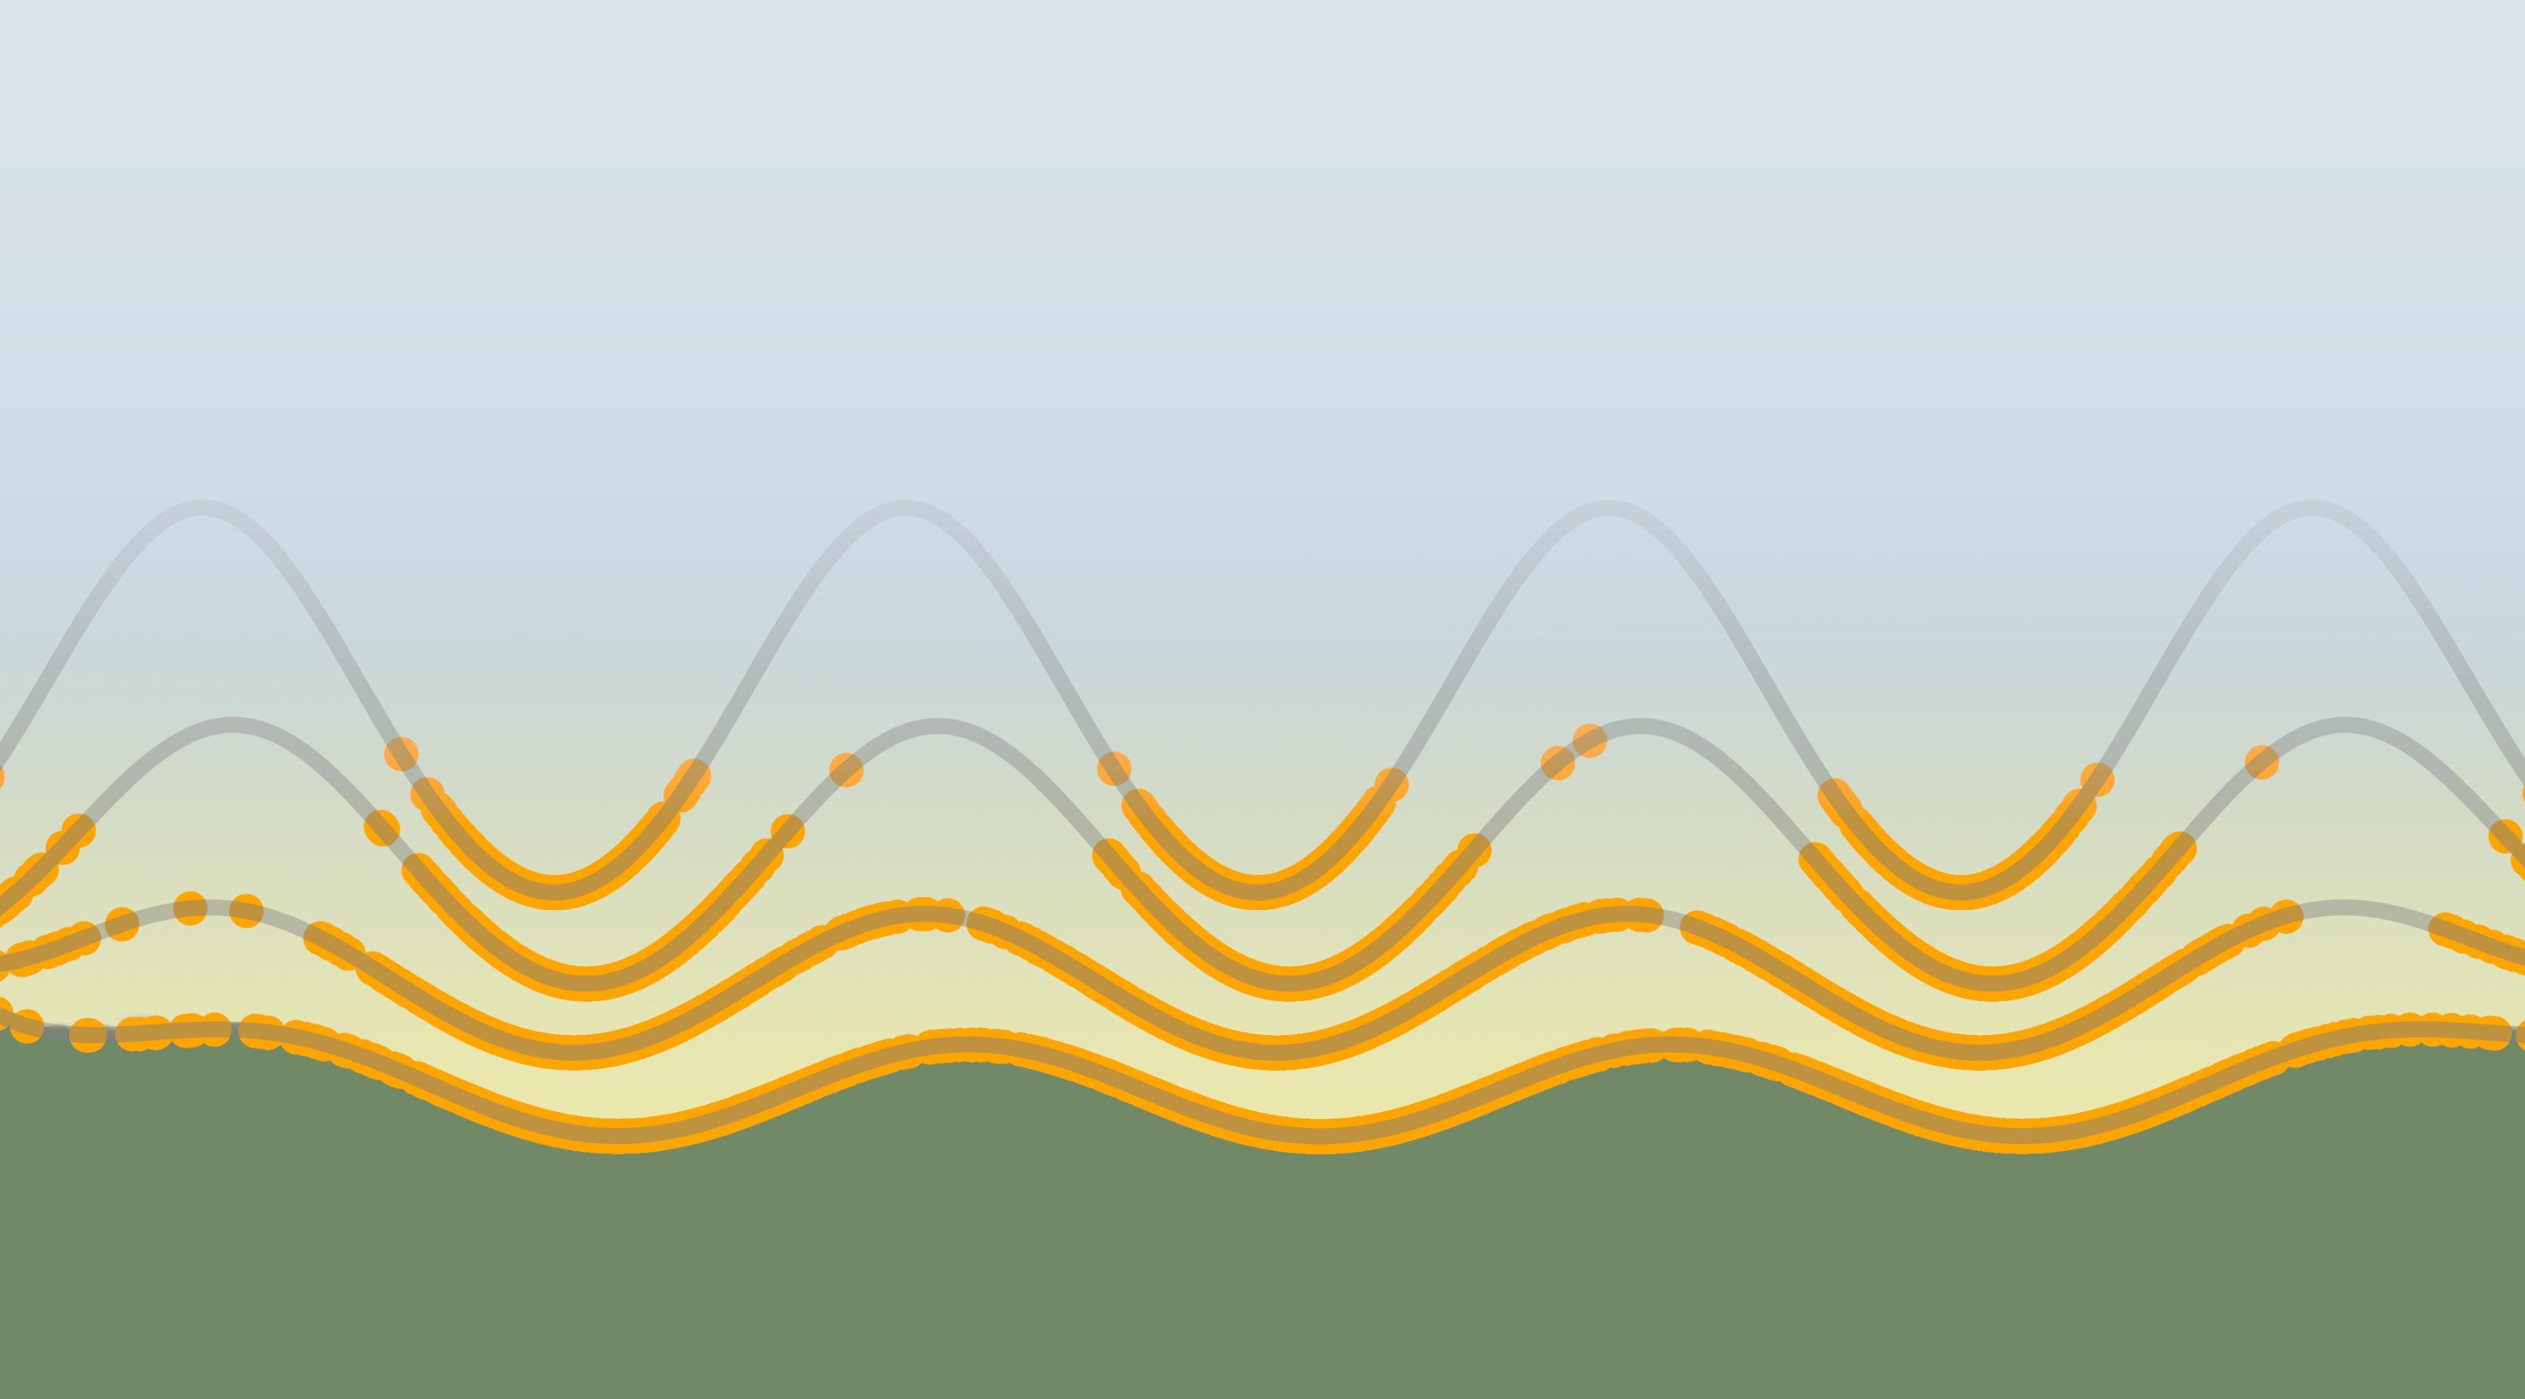
Free Energy Methods: Drug-Like Molecules and Macrocycles
Benjamin J. Ries
Defense Talk, 12/01/2022
Notes:
Introduction
Relative binding free energies
Combination of two methods.

Slide 2
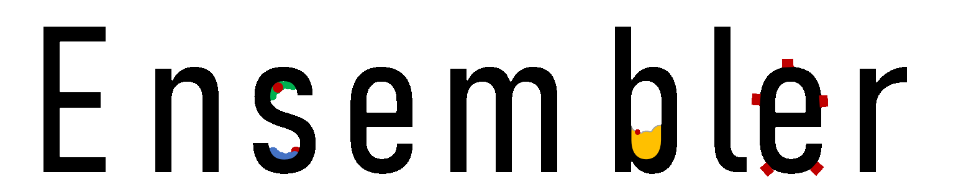
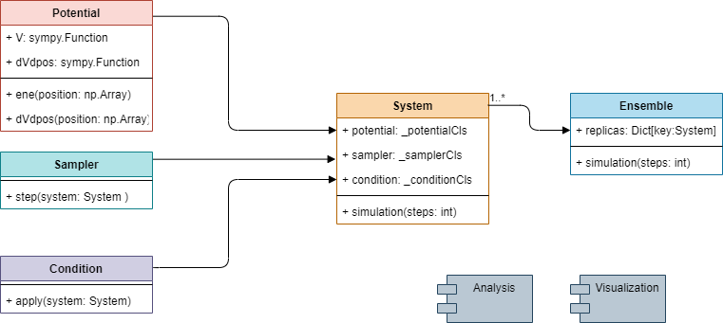
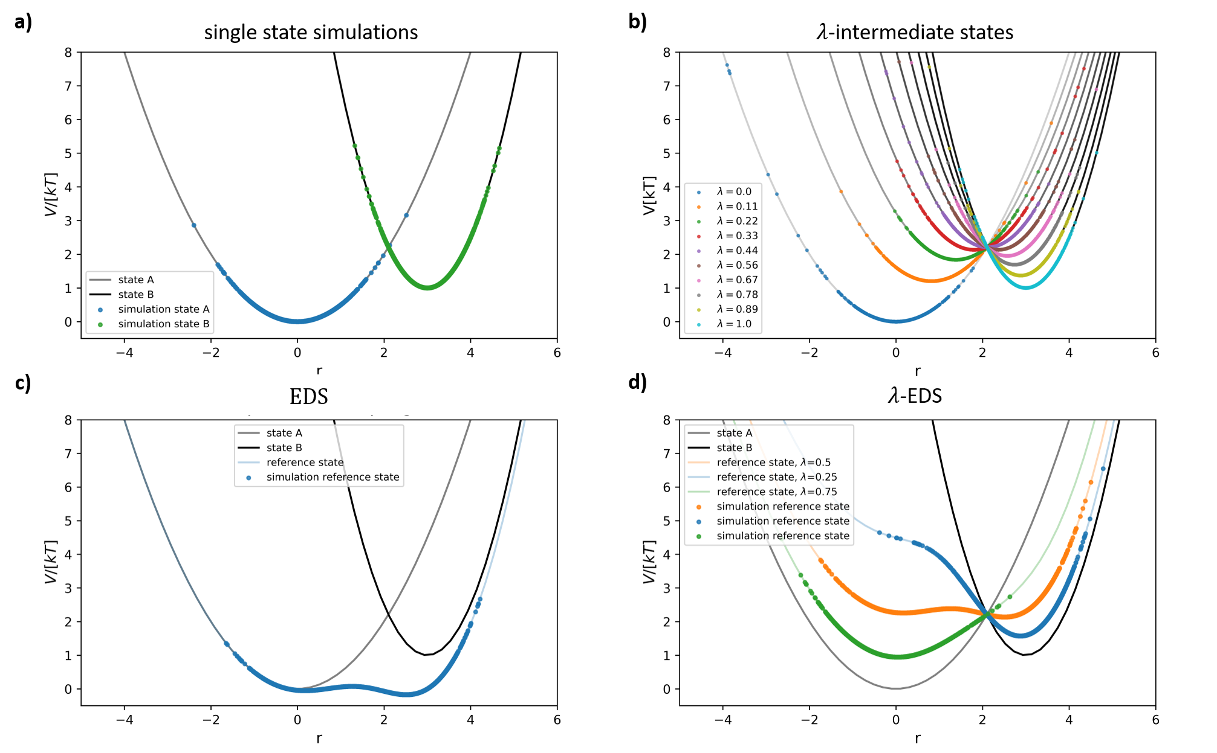
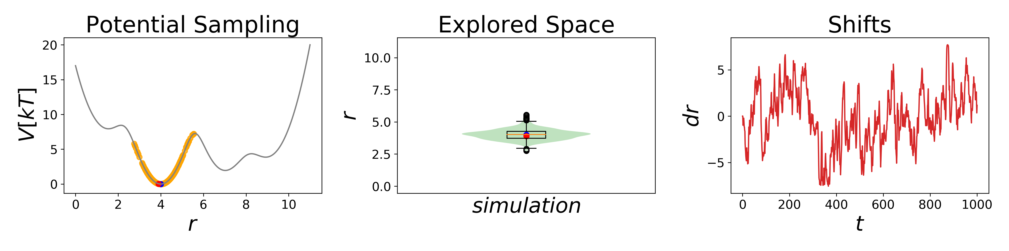
Ch 2 - A Simple Package for Fast Prototyping and Teaching Molecular Simulations
UML Scheme
Free Energy Methods in 1D
Example 1D simulation
Ries B., Linker S. M., Hahn D. F., König G., and Riniker S. - Journal of Chemical Information and Modeling 2021 61 (2), 560-564

Slide 3

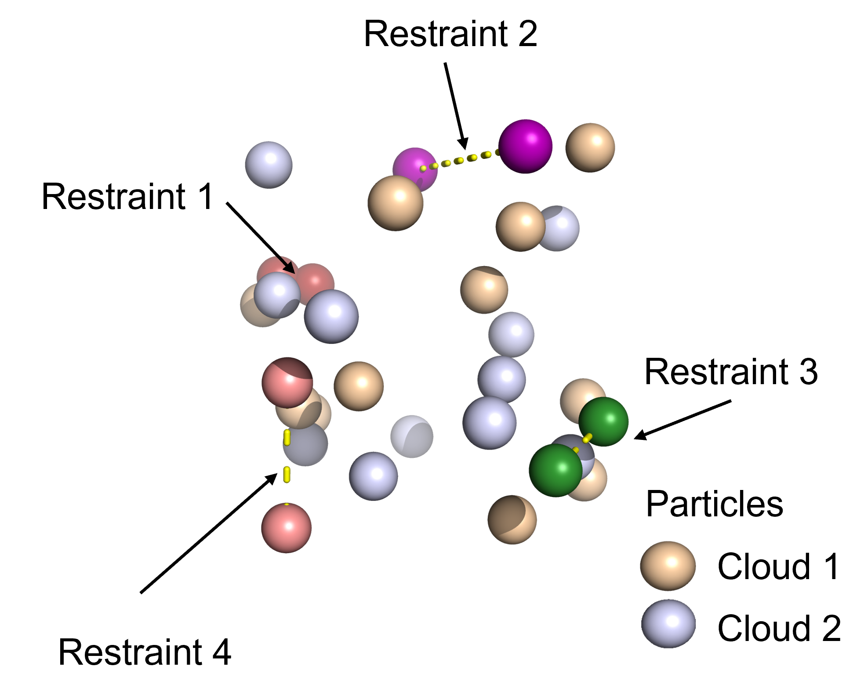
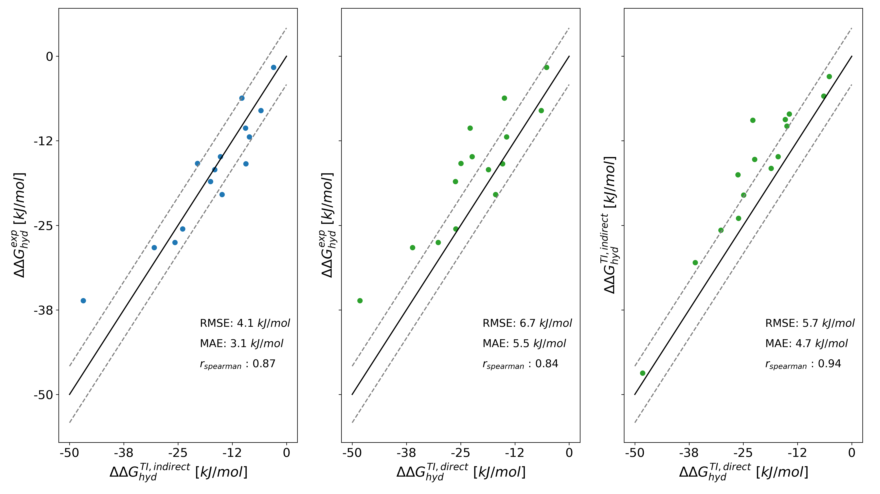
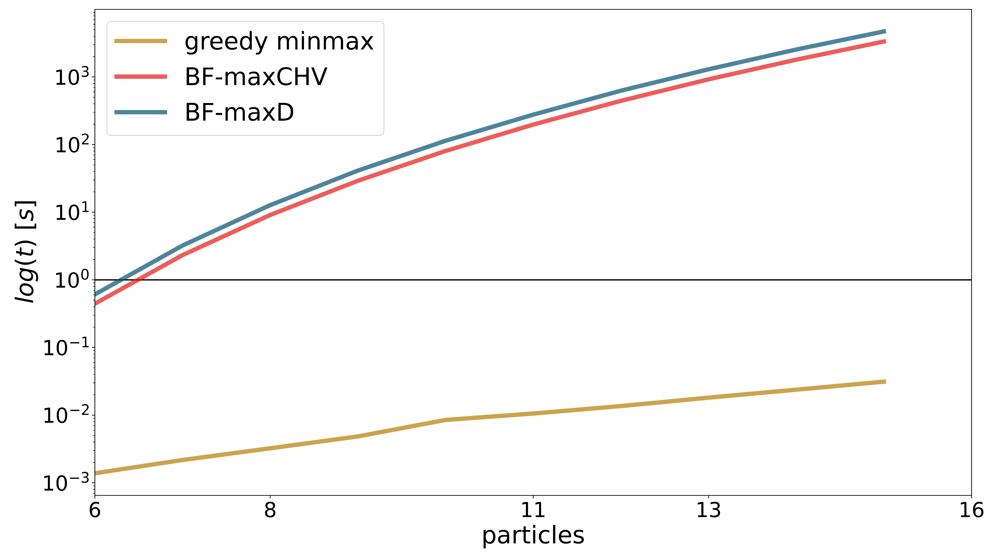
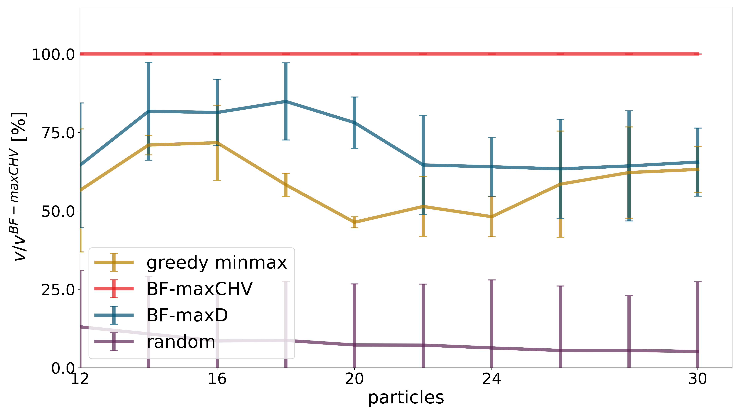
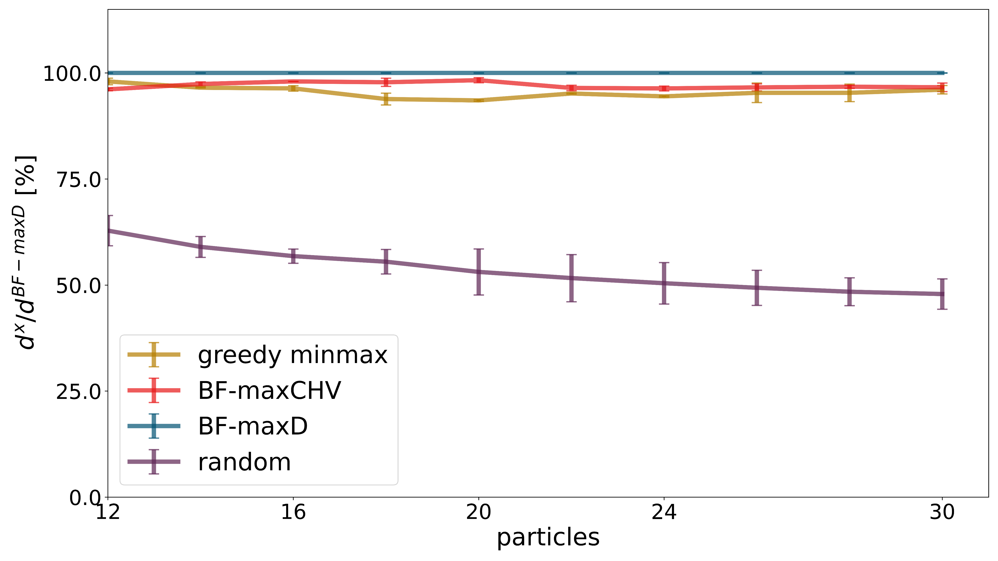
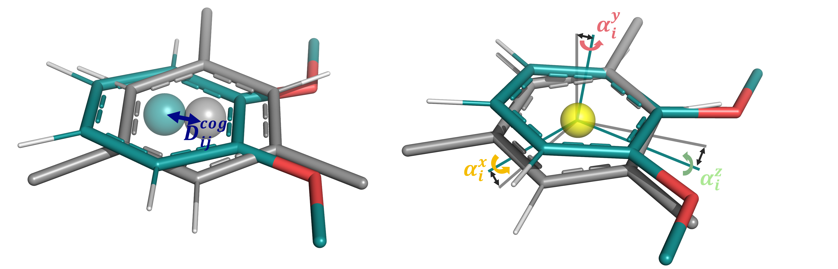
Ch 3 - A Graph-Based Approach to Select Distance Restraints in Free- Energy Calculations with Dual Topology
Testing Algorithm on Toy Model
Relative Hydration Free Energy Calculation
4
14
1
12
7
5
Ries B., Rieder S., Rhiner C., Hünenberger P. H., Riniker S. - J Comput Aided Mol Des (submitted)

Slide 4
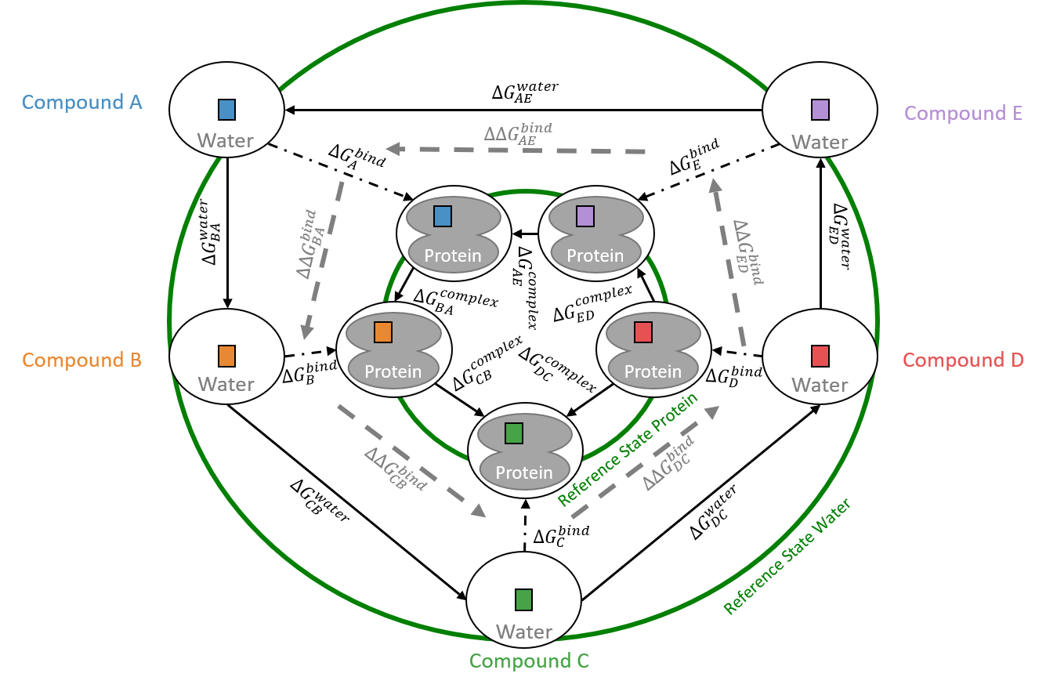
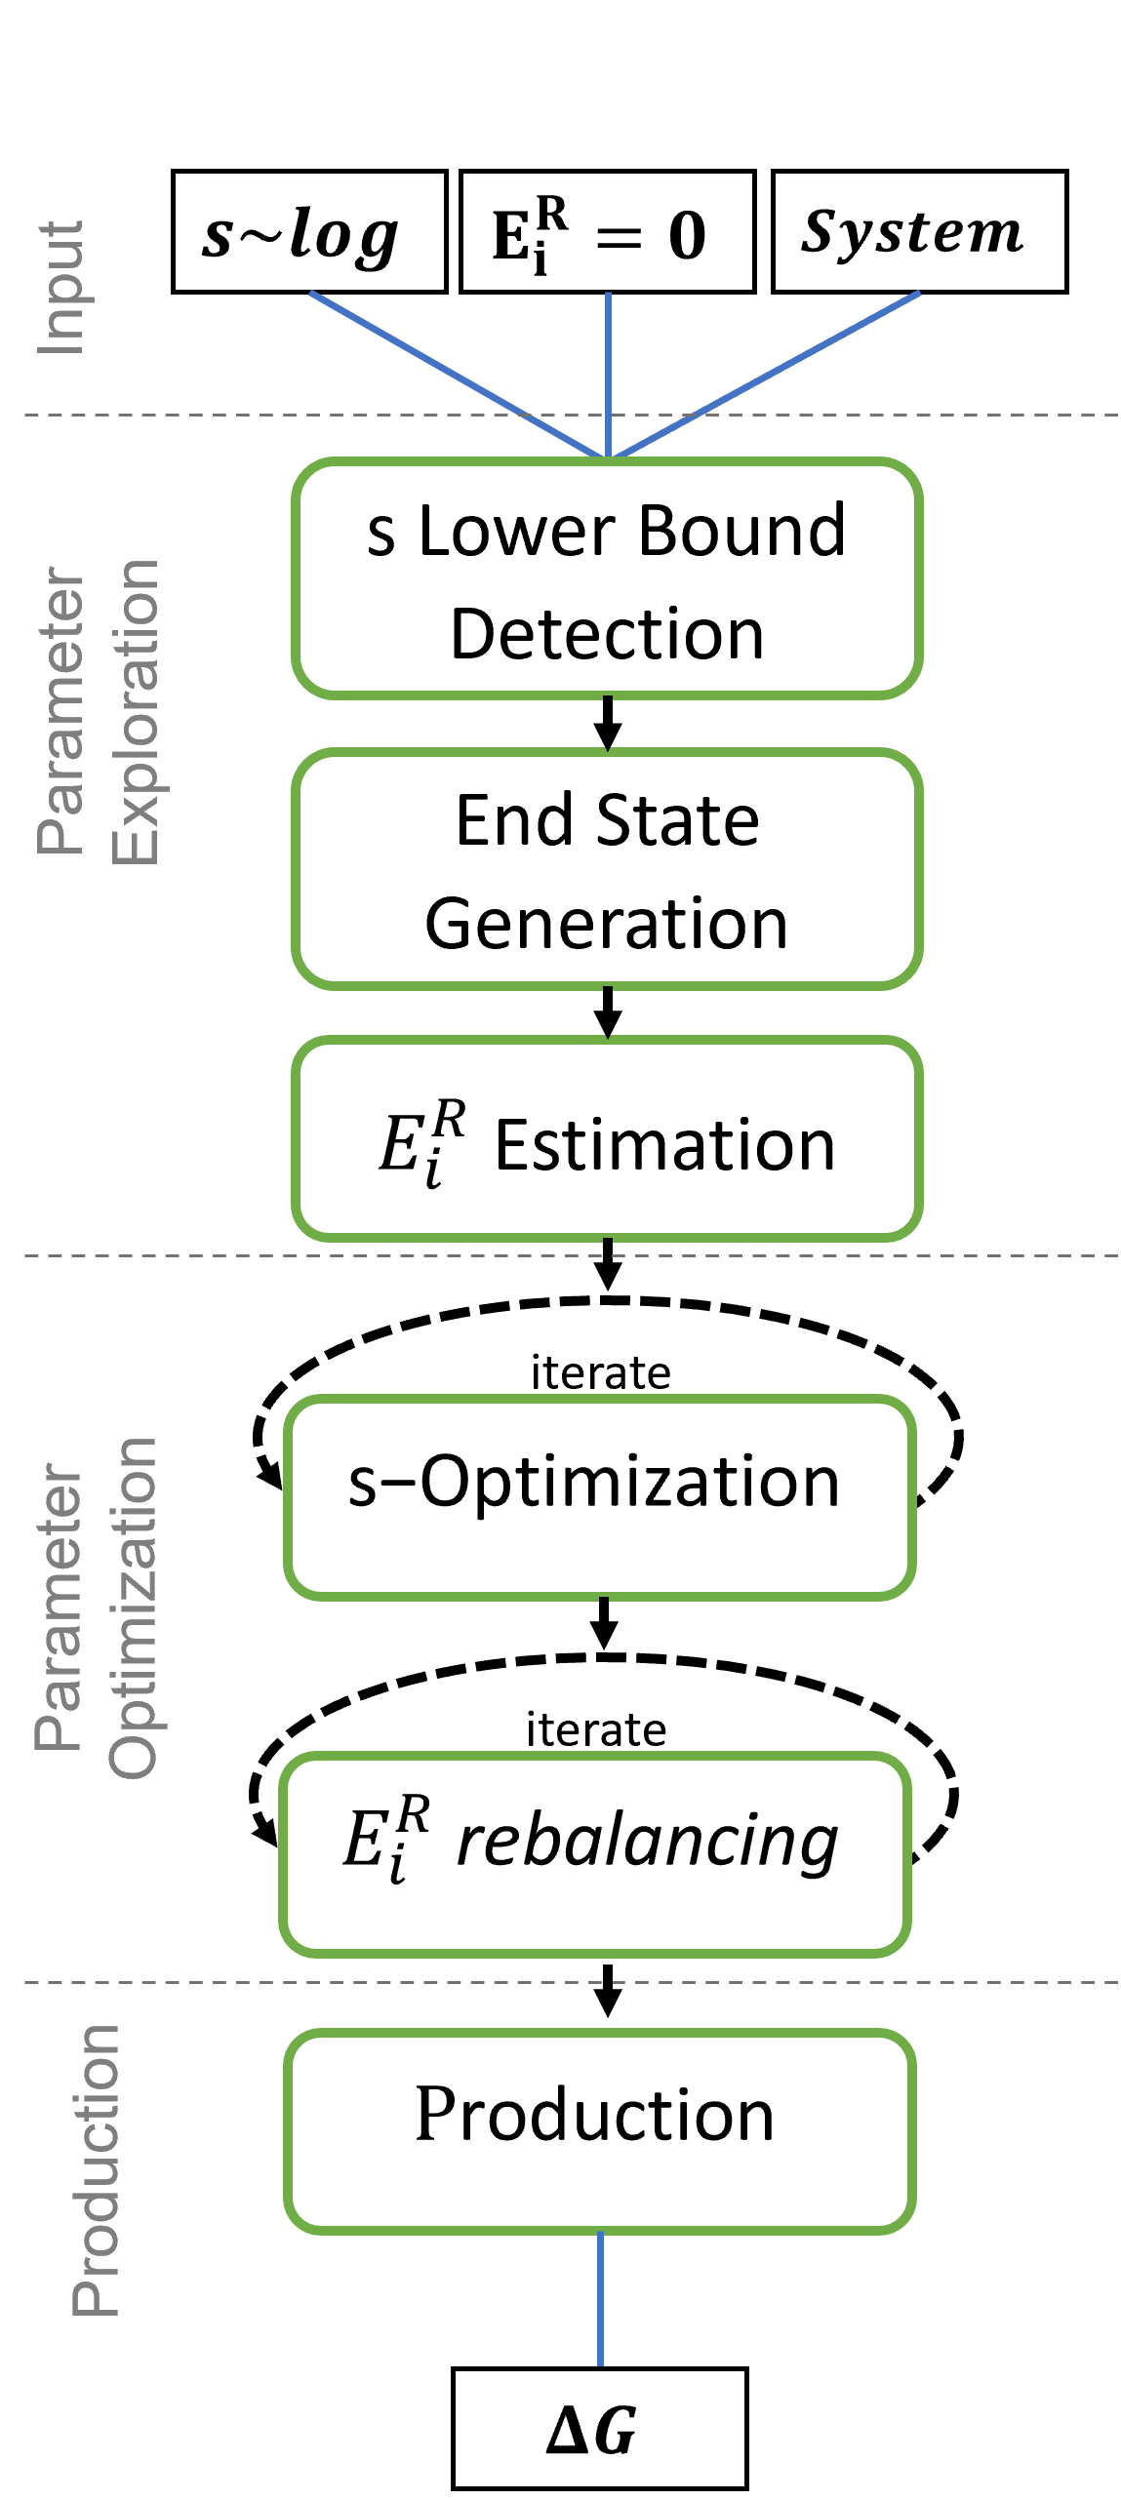
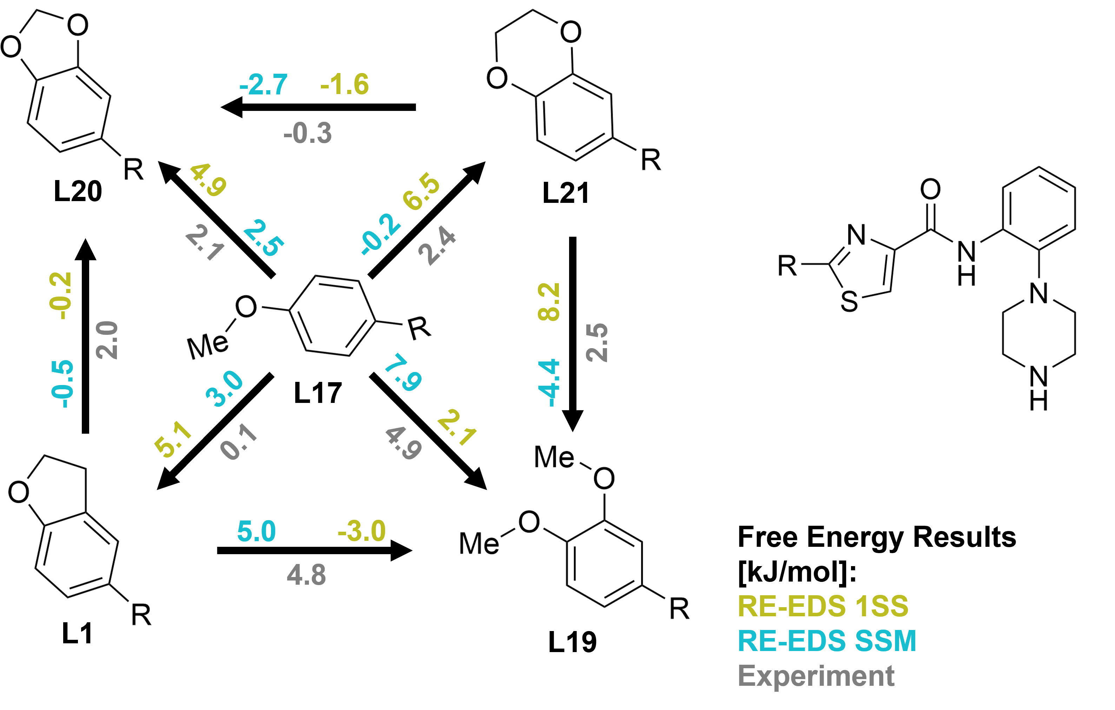
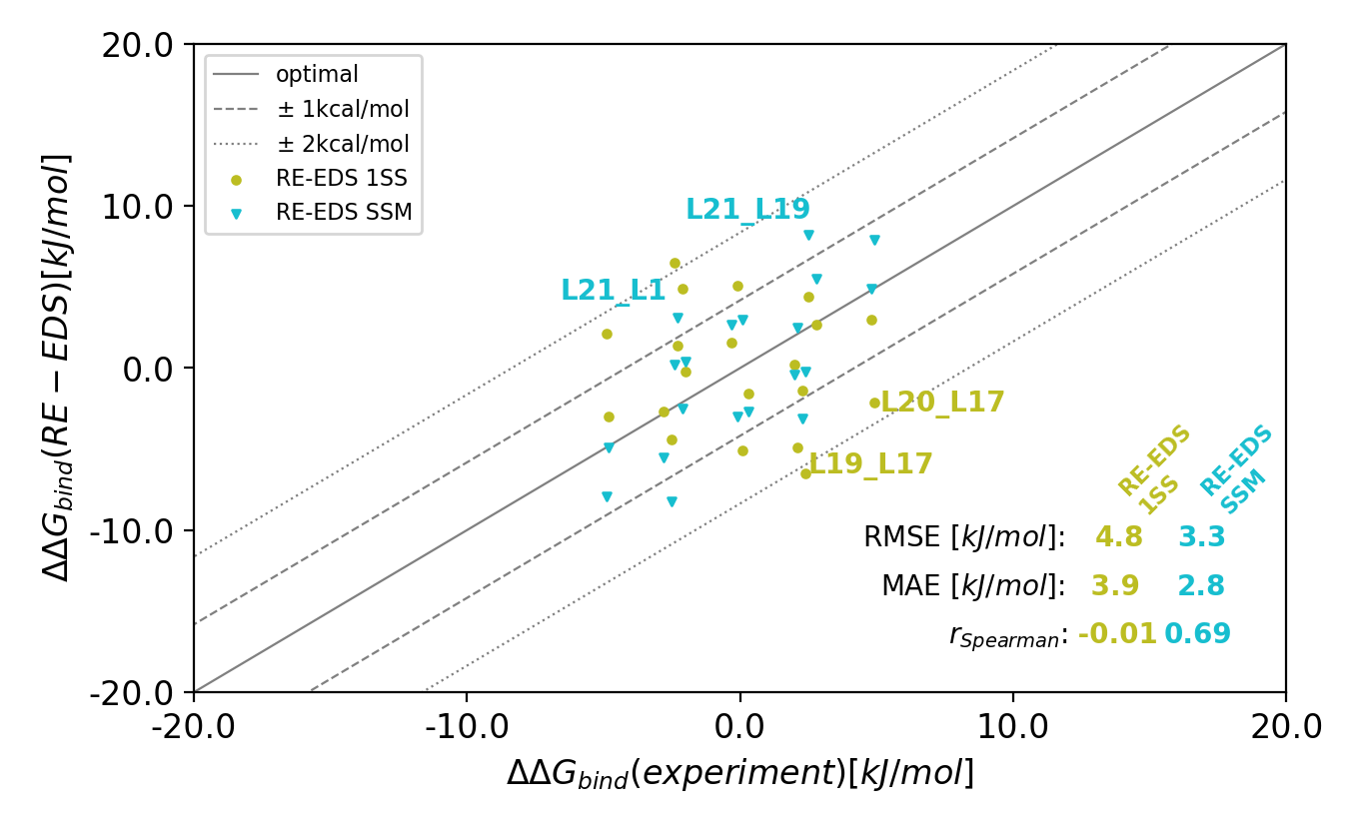
Ch 4 – Relative Free-Energy Calculations for Scaffold Hopping-Type Transformations with an Automated RE-EDS Sampling Procedure
Current Pipeline
Comparison Calculated Results vs. Experiment
Ries, B., Normak, K., Weiß, R.G. et al. - J Comput Aided Mol Des (2022)

Slide 5
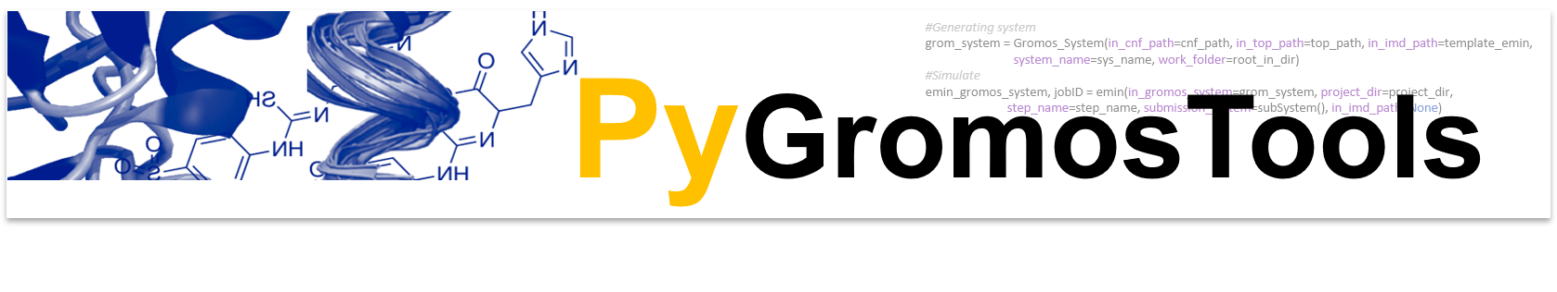
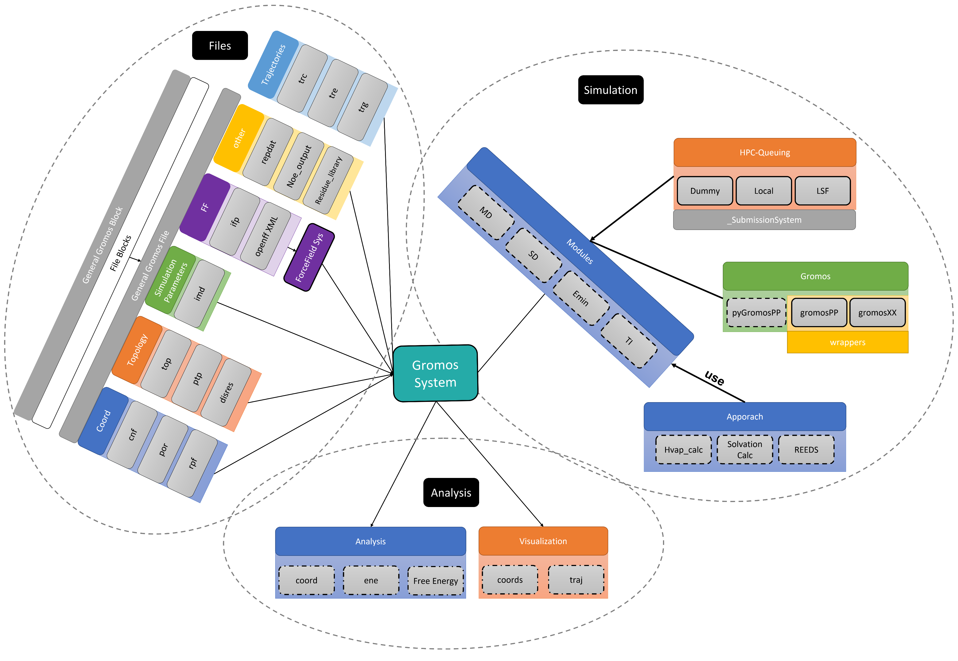
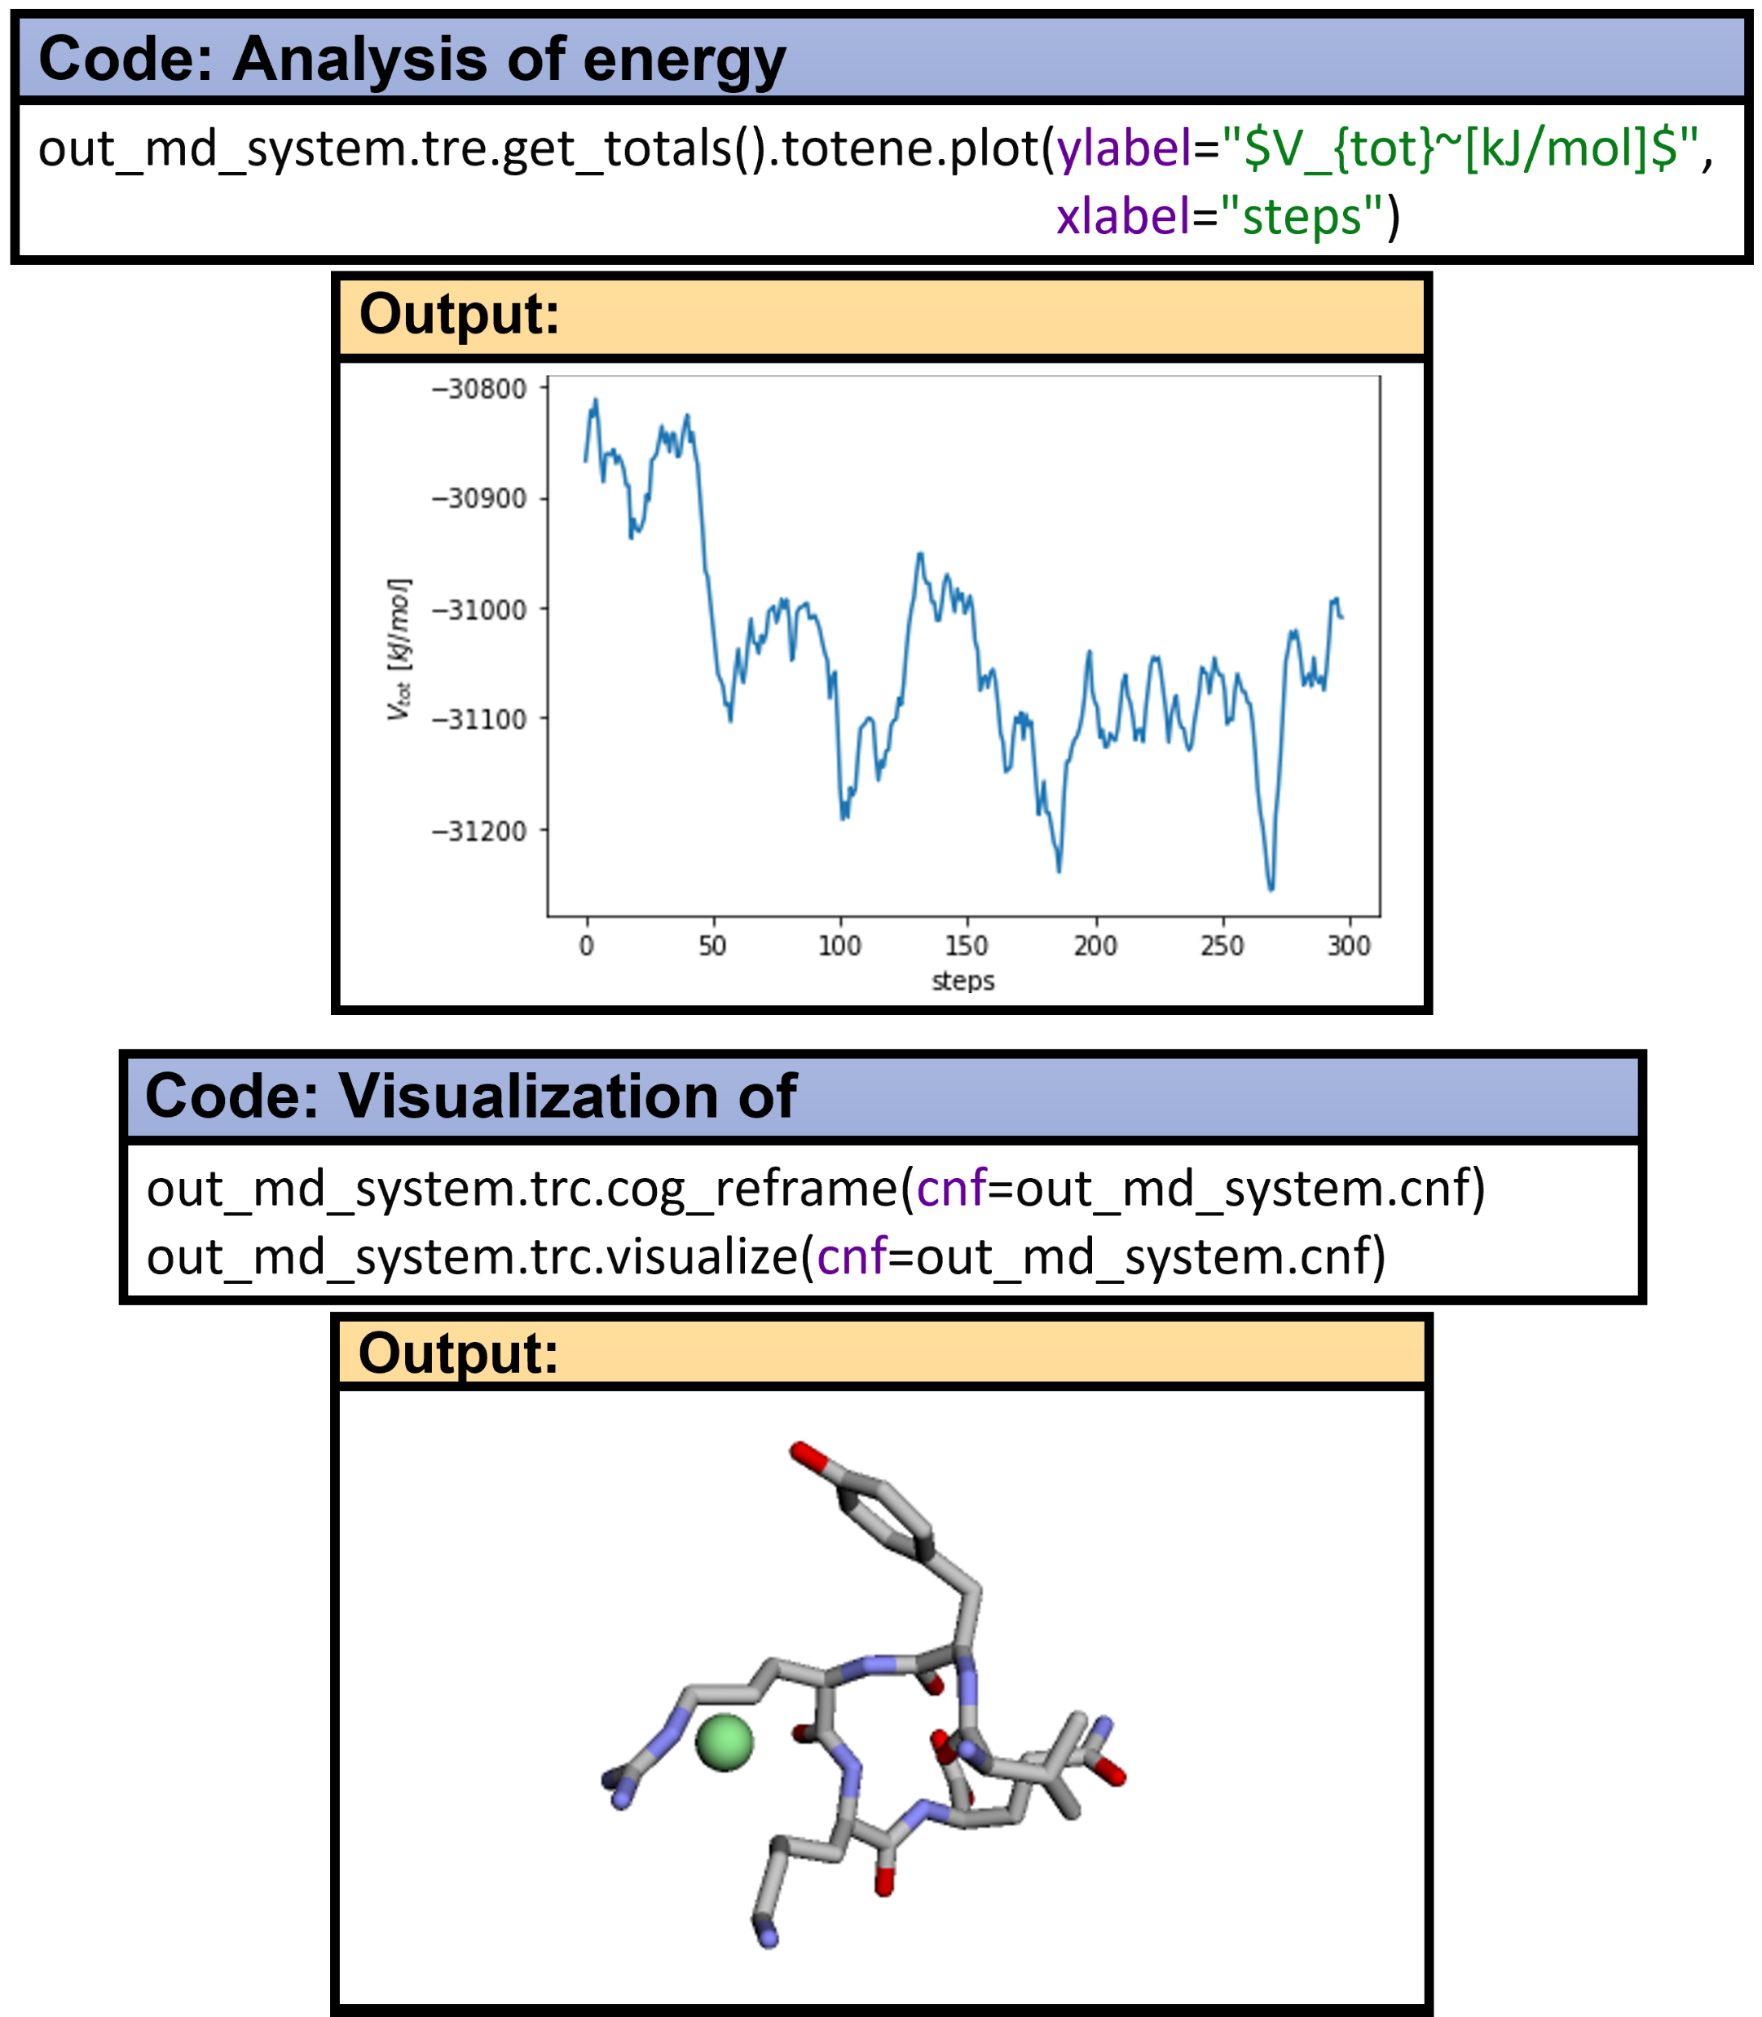
Ch 5 - A Fast and Flexible API for the Molecular Dynamics Software Package GROMOS
Code Structure
Code Example

Slide 6
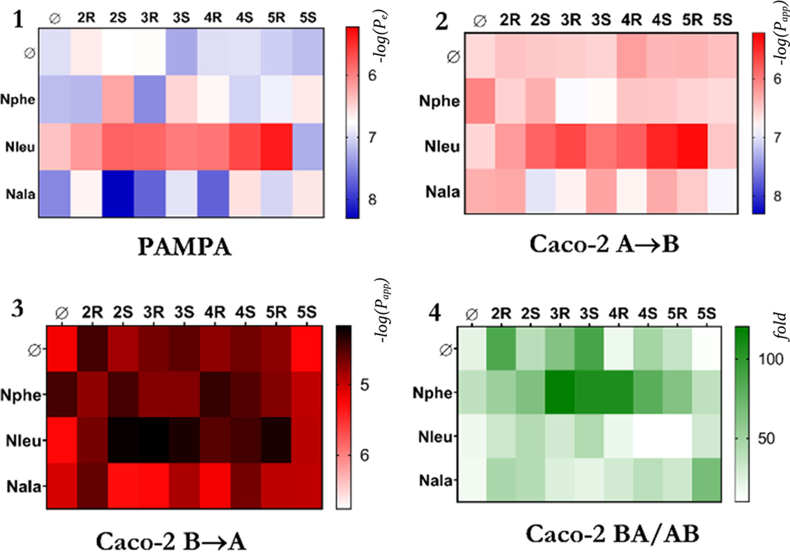
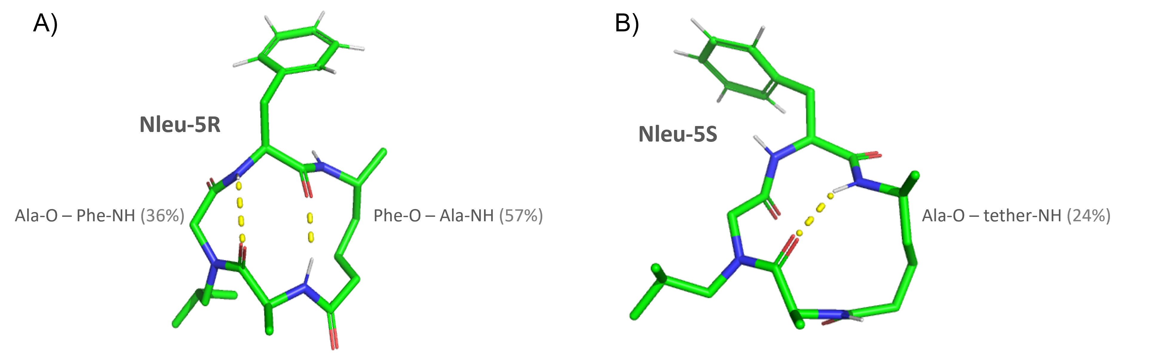
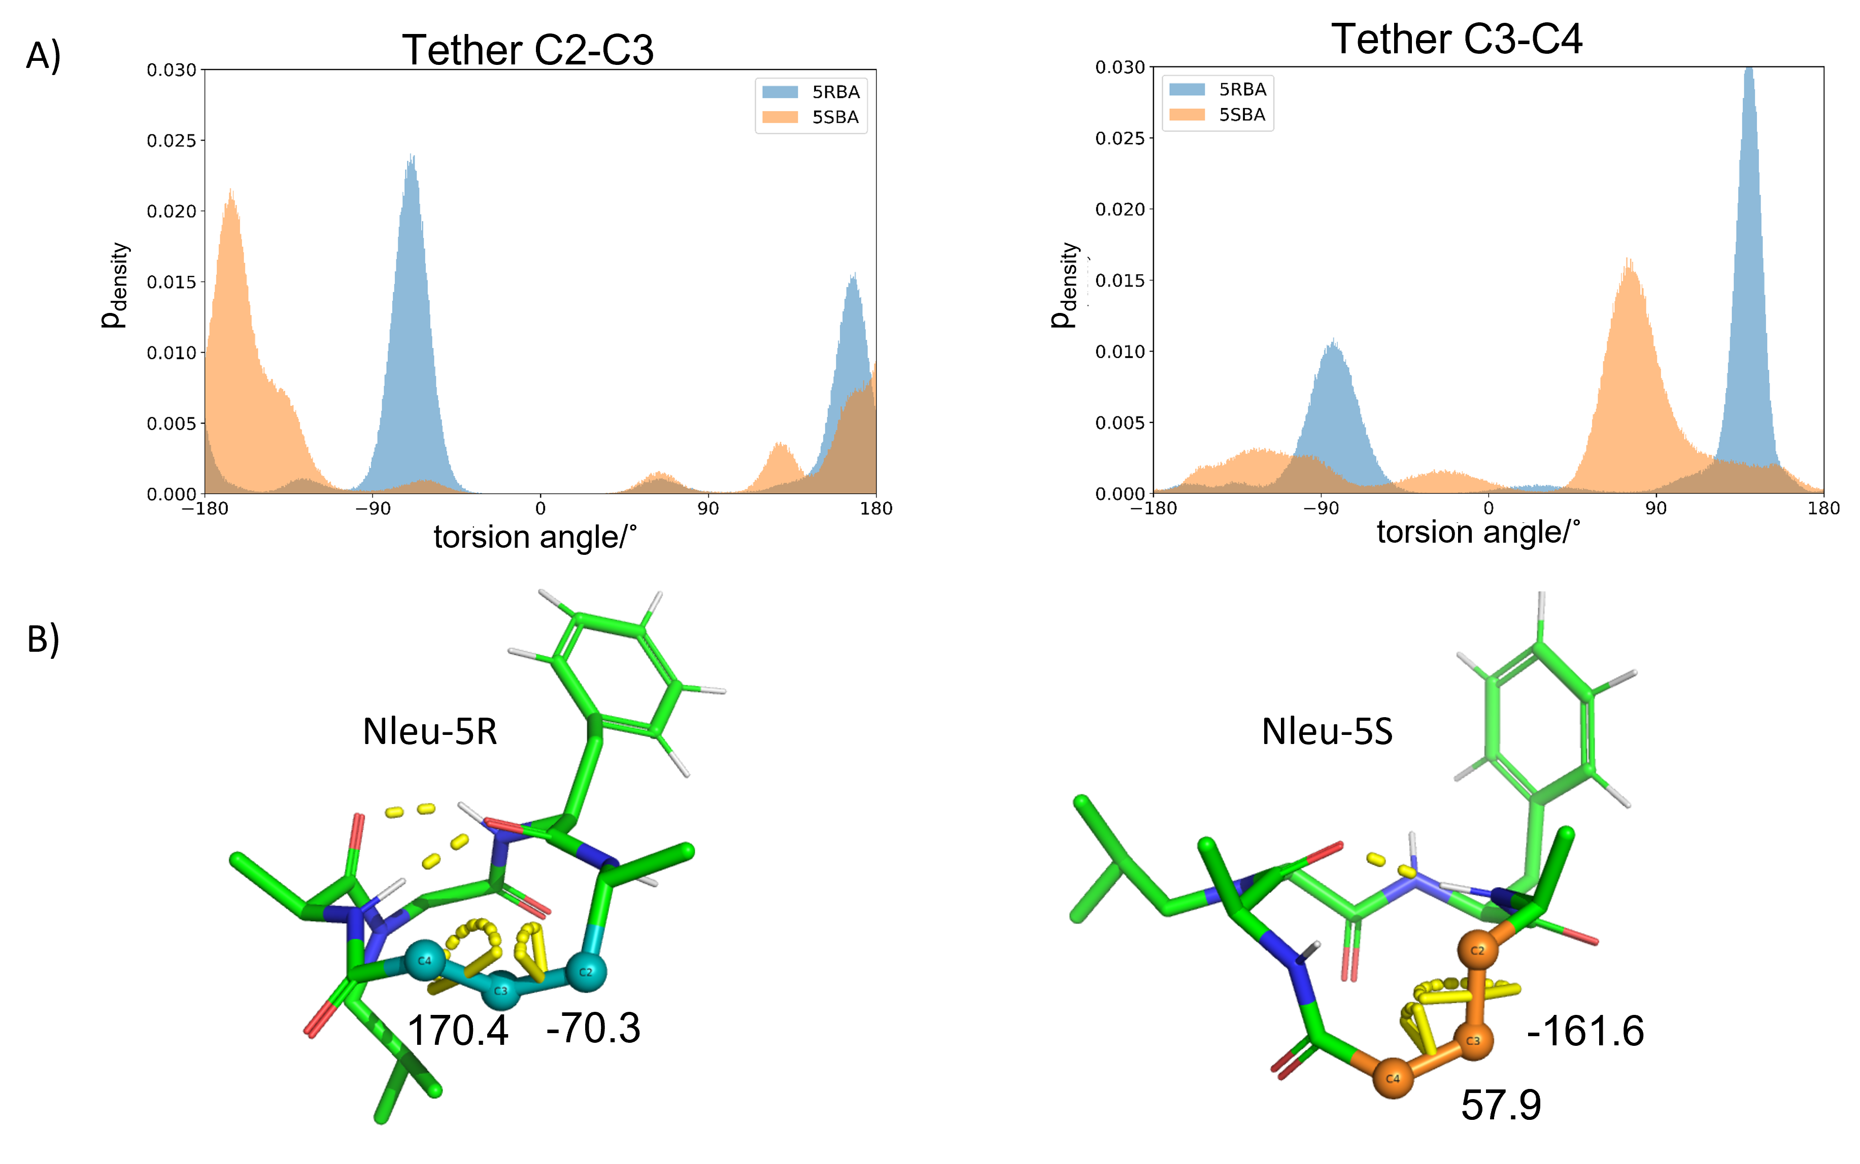
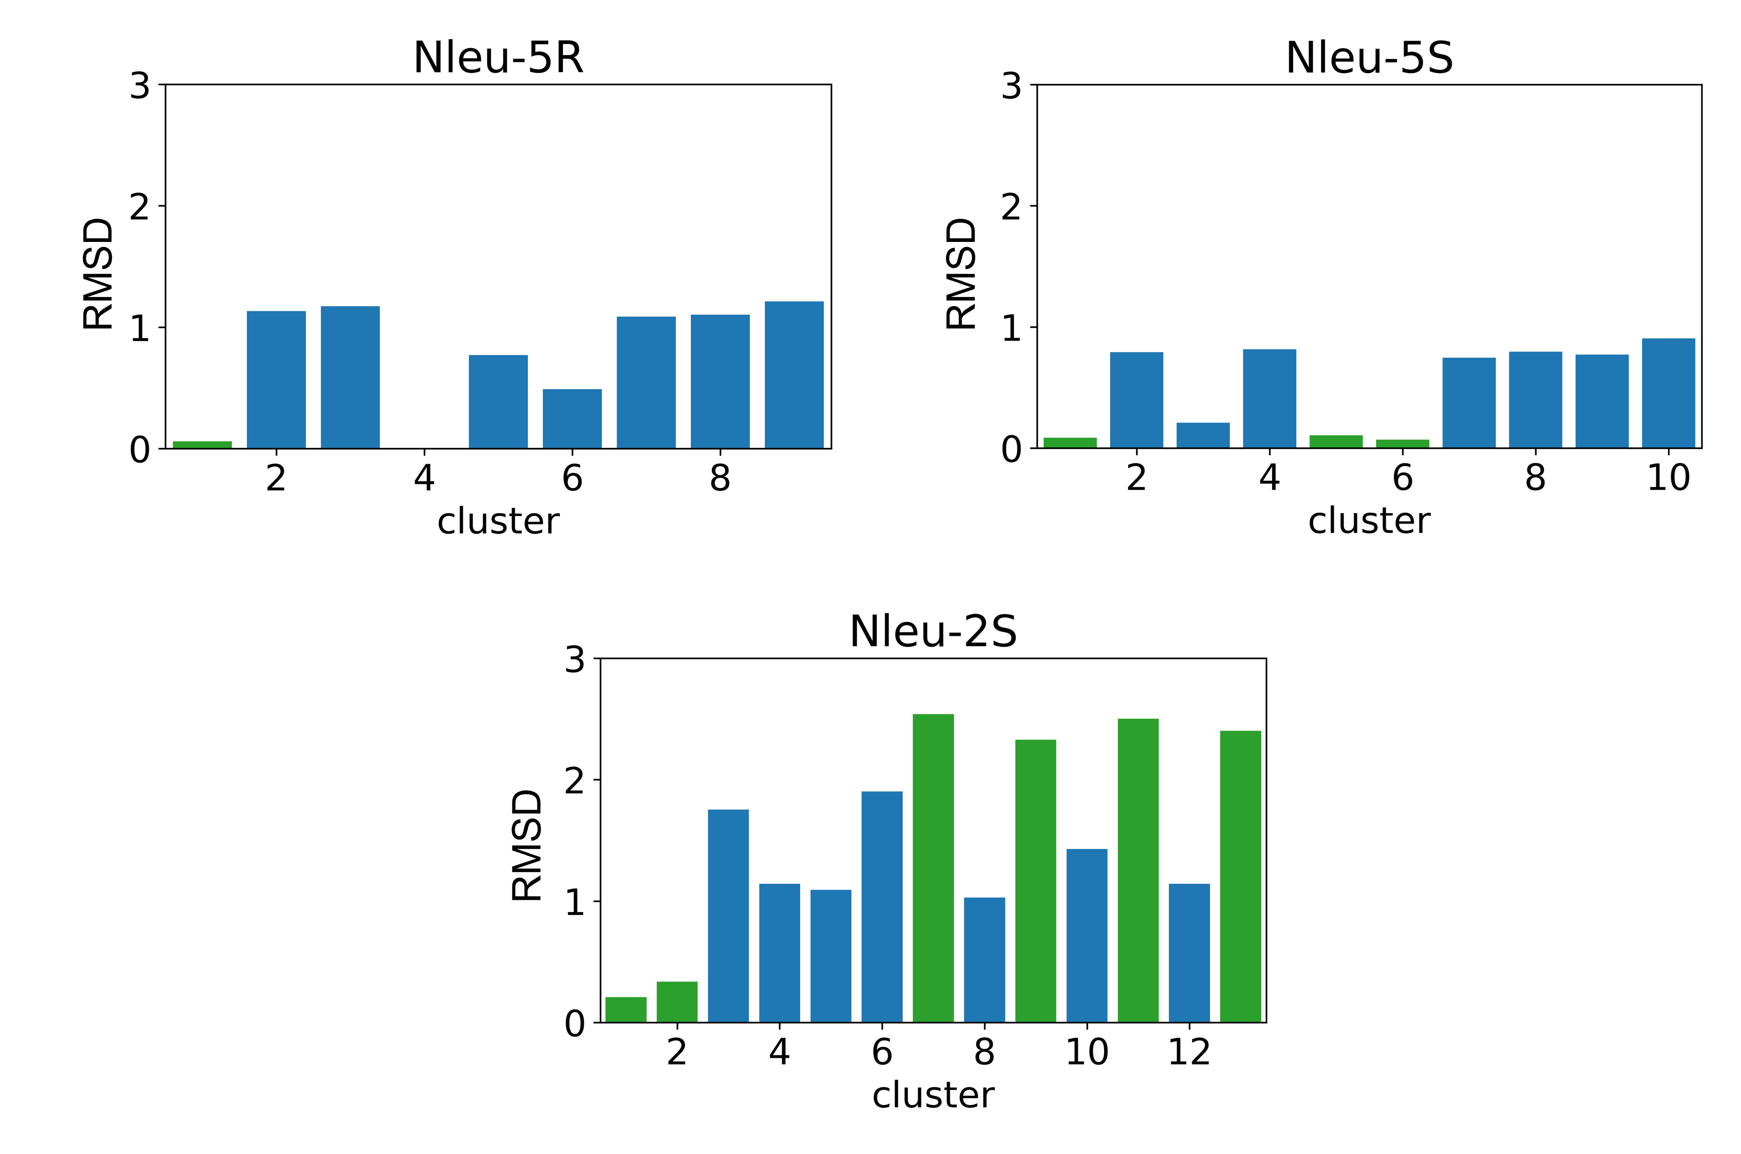
Ch 6 – Modulation of the Passive Permeability of Semipeptidic Macrocycles Based on the Stereochemistry Change of a Single Atom.
Experiment
Changes found in MD
Comparing MD and NMR Experiments
Christian Comeau, Benjamin Ries, Thomas Stadelmann, et al. - Journal of Medicinal Chemistry 2021 64 (9), 5365-5383

Slide 7
Free Energy Methods: Drug-Like Molecules and Macrocycles
Benjamin J. Ries
Defense Talk, 12/01/2022
Notes:
Introduction
Relative binding free energies
Combination of two methods.

